Slide 1
Maven

Slide 2
Topics
Maven
Dependencies
Configuring Local Repo
Archetypes
Build Lifecycles
Goals
Maven with Eclipse

Slide 3
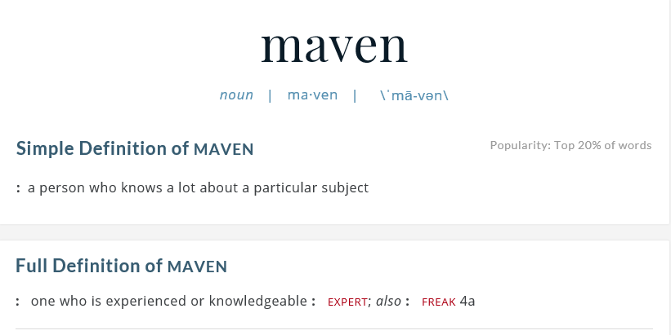
Maven
Build automation tool created by Apache in 2002
Project Object Model (POM)
Manages a project’s:
Build
Reporting
Documentation
pom.xml configures a project’s:
Coordinates (groupID, artifactId, version)
Dependencies to other projects (i.e. JARs)
Build plugins
Build goals/profiles
Source and target directories

Slide 4
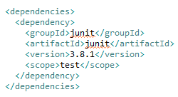
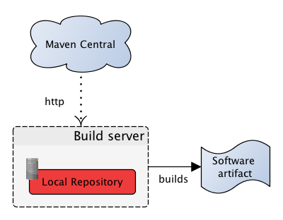
Dependencies
Maven Central Repository is a JAR warehouse
If your local repo doesn’t have a JAR:
JARs automatically downloaded and added to project
Simple XML tags in the POM file
Just use the project coordinates
You specify the version to use!

Slide 5
Configuring Local Repo
Navigate to:
{M2_HOME} / conf / setting.xml
Set local repo location:
<localRepository>C:/apache-maven-3.3.3/local-repo</localRepository>
All local Maven artifacts will go to this folder
Maven will check Local for JARs first before going to Central
You can create a Remote Repo using Nexus to share with other developers, too!

Slide 6
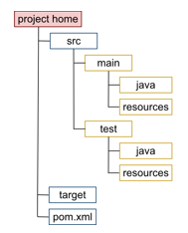
Archetypes
Maven Archetypes create a template directory structure
Proven patterns or models for projects
There are over 1,000 different archetypes:
Web apps
JSF projects
And more!
Creates folders and project structure
Folders for test cases to automatically run unit tests

Slide 7
“Default” Build Lifecycle
validate - validate the project is correct and all necessary information is available
compile - compile the source code of the project
test - test the compiled source code using a suitable unit testing framework. These tests should not require the code be packaged or deployed
package - take the compiled code and package it in its distributable format, such as a JAR.
integration-test - process and deploy the package if necessary into an environment where integration tests can be run
verify - run any checks to verify the package is valid and meets quality criteria
install - install the package into the local repository, for use as a dependency in other projects locally
deploy - done in an integration or release environment, copies the final package to the remote repository for sharing with other developers and projects

Slide 8

“Clean” Build Lifecycle
pre-clean - execute processes needed prior to the actual project cleaning
clean - remove all files generated by the previous build
post-clean - execute processes needed to finalize the project cleaning

Slide 9
“Site” Build Lifecycle
pre-site - execute processes needed prior to the actual project site generation
site - generate the project's site documentation
post-site - execute processes needed to finalize the site generation, and to prepare for site deployment
site-deploy - deploy the generated site documentation to the specified web server

Slide 10

Goals
A goal represents a specific task which contributes to the building and managing of a project.
May be bound to zero or more build phases
mvn test
Compile > Validate > Test
A goal not bound to any build phase could be executed outside of the build lifecycle by direct invocation.
mvn archetype:generate

Slide 11
Maven with Eclipse
Plugin integrates Maven functionality with Eclipse
Create Maven projects from Archetypes
Manage a project’s POM (XML and GUI)
Perform Maven phases and builds
Clean
Install
Deploy
And many more
Eclipse Mars is shipped with the plugin

Slide 12
Review
Maven
Dependencies
Configuring Local Repo
Archetypes
Build Lifecycles
Goals
Maven with Eclipse

